Slide 1
Predicting 30-Day Hospital Readmission For Diabetic Patients
Oct 11, 2023
Aditi Gupta || Dollaya Hirunyasiri
Greta Luo || Jorge Palacio

Slide 2
Agenda
01
The problem
02
Exploring Data
- Datasets
- Cleaning data
- Pre-processing data
- Background
- Problem characteristics
- Considerations
03
Analytics
04
Future project plan
- Standardization
- Clustering
- Model Building
- Data Understanding
- Deployment
- Risks and Mitigation Plans

Slide 3
PART 1
The Problem

Slide 4






American hospitals spent over $41B on diabetic patients readmitted within 30 days of discharge
Readmitted < 30 days
Hospital
Extra costs for health system
Health risks for patient
Bad experience for patients + families
Discharge?
?
30 days
Source: Auerbach, et al, “Preventability and Causes of Readmissions in a National Cohort of General Medicine Patients,” https://jamanetwork.com/journals/jamainternalmedicine/fullarticle/2498846

Slide 5

Framing the problem of hospital readmission
?
Decision to be improved Whether a diabetic patient should be discharged from the hospital
Decision maker Medical staff involved in the day-to-day functioning of a hospital
Value of improved decision Less health risk for patients Lower cost for health system Better experience: patients + families
Hypothesis The strongest predictors that contribute to hospital readmission of diabetic patients will be identified - help to improve the decision

Slide 6


For a successful deployment in real hospitals, the analytic model should be interpretable and fast
Health personnel prefer an interpretable model rather than a “black box” model
Results should be available in human response times - less than 10 seconds

Slide 7
PART 2
Exploratory Data
Analysis

Slide 8




Dataset details
‘Diabetic_data.csv’ (101,766 data points)
years of data
(1999-2008)
US hospitals
Features (Mostly categorical)
‘IDS_mapping.csv’ (Labels for 3 data columns)

Slide 9
101,766
Data points
Records of patients who stayed up to
14 days
71,518
Unique patients
Notes:
10 years of data ( 1999-2008)
101,766 data points from 130 US hospitals
Records of patients who stayed up to 14 days
Includes 50 features
Mostly categorical data
71518 unique patients

Slide 10
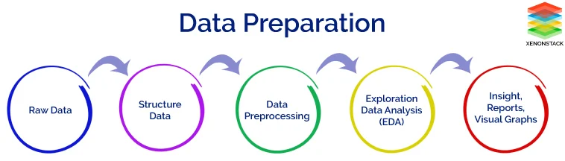
Dropping columns
Checking for outliers
Dropping duplicates
Replacing “?” with appropriate values
Notes:
Dropping columns not relevant for analysis
Checking for outliers in numeric columns
Dropping duplicates
Replacing “?” with mean for numerical columns and mode for categorical columns

Slide 11
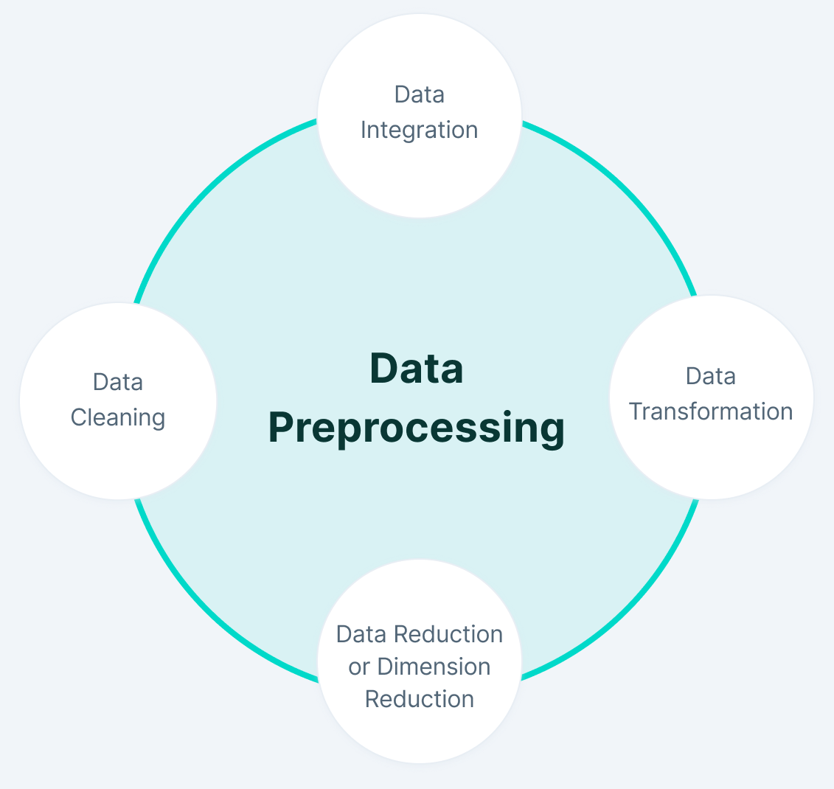
Two labels for dependent variable:
Readmitted within <30 days
No readmission or readmitted within >30 days
Converting categorical data into numerical data
Replacing Ranges with mean
Standardizing the data for model preparation
Notes:
Identifying two labels for dependent variable:
Readmitted within <30 days
No readmission or readmitted within >30 days
Converting categorical data into numerical data: one-hot encoding or dummy variables
Replacing Ranges with mean
Standardizing the data for model preparation

Slide 12
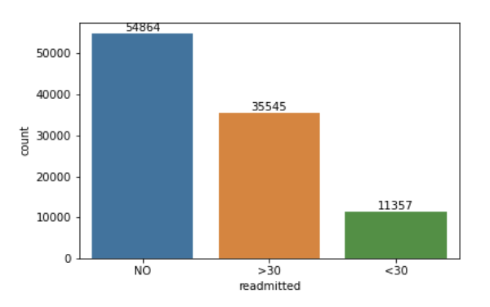
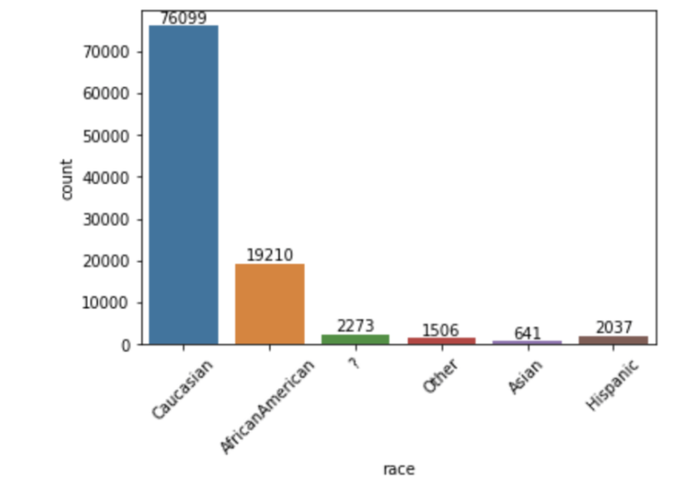
Example One Variable EDA
Figure 1 displays displays the counts for readmission with the majority of patients with no record of readmission.
Figure 2 displays counts for race with the overwhelming majority of patients being Caucasian.

Slide 13
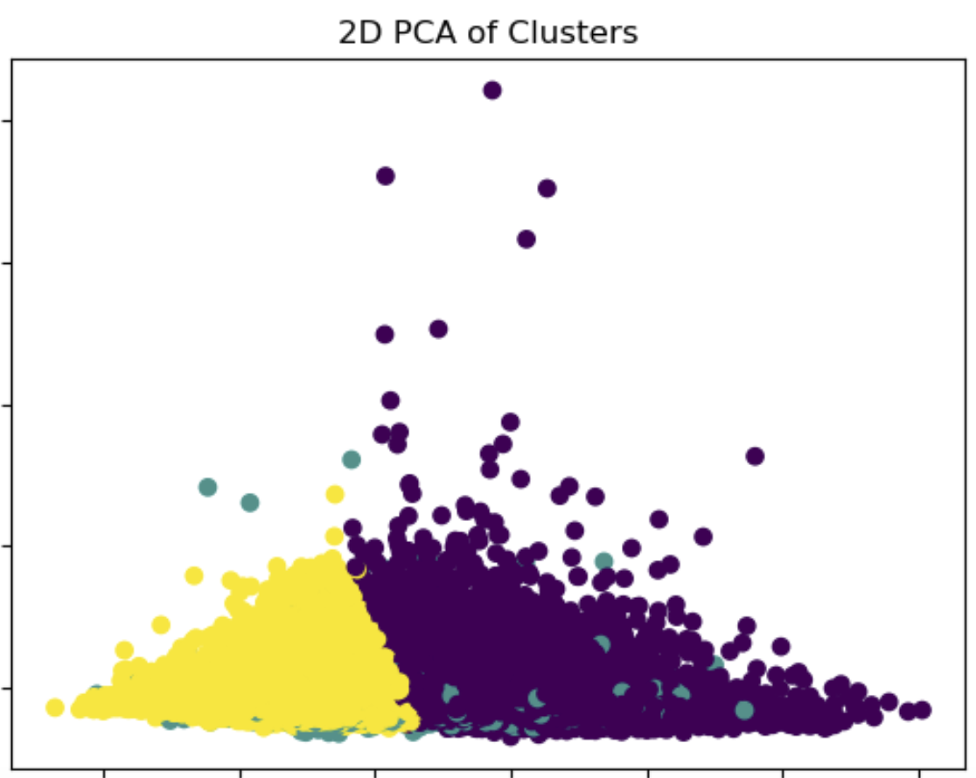
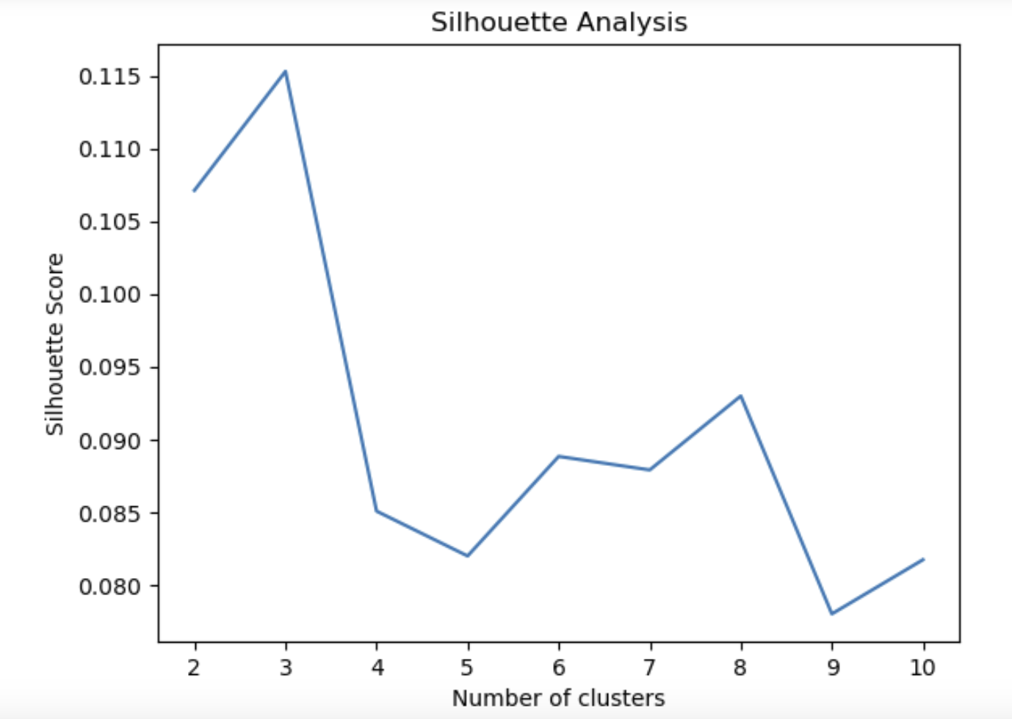
Clustering - using Silhouette Method
2 clusters formed: Can be used for patient segmentation by analyzing features of the clusters and commonality.

Slide 14
PART 3
Analytics

Slide 15
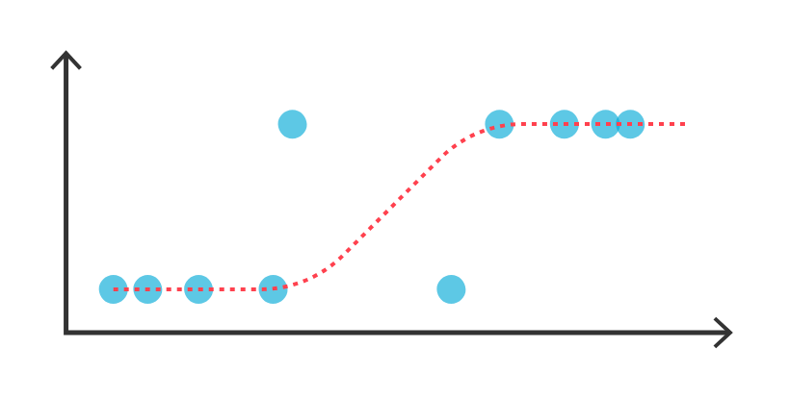
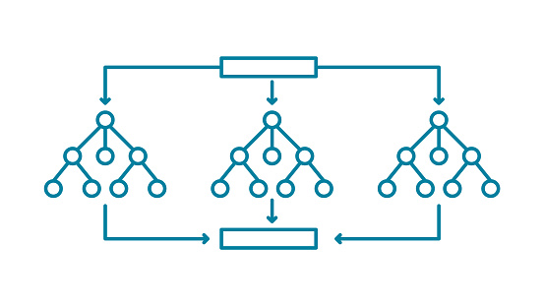
Model Selection
Binary Logistic Regression
✔️Predicts probability ✔️Easy to interpret ❌Input variables numeric or ordinal
Decision tree
✔️Handles Categorical Variables ✔️Easy to interpret ❌Lower accuracy
Random Forest
✔️Handles Categorical Variables ❌Difficult to interpret ✔️Higher accuracy
Notes:
non-linear model and can capture complex relationships between input variables and the target variable

Slide 16
Decision Tree Results on Validation Set
Train Validation Split (70, 30)
 | Predicted Label = 0 (patient not readmitted < 30 days) | Predicted Label = 1 (patient readmitted < 30 days)
Label = 0 (patient not readmitted < 30 days) | 1786 | 1577
Label = 1 (patient readmitted < 30 days) | 1523 | 1929
Accuracy | 54.51%
Precision | 55.02%
Recall | 55.88%
F-1 Score | 55.45%
Decision Tree Metrics
Decision Tree Confusion Matrix

Slide 17
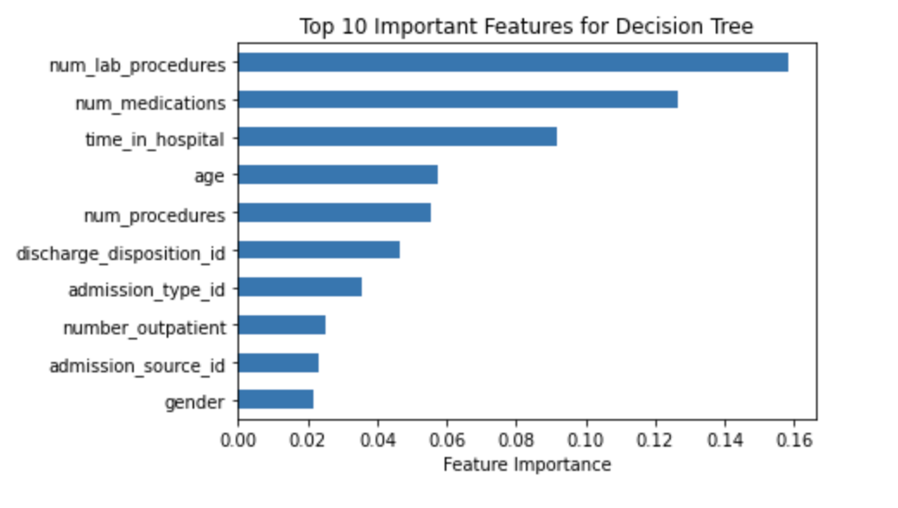
Decision Tree Important Features

Slide 18
Random Forest Results on Validation Set
Same Train and Validation Set
 | Predicted Label = 0 (patient not readmitted < 30 days) | Predicted Label = 1 (patient readmitted < 30 days)
Label = 0 (patient not readmitted < 30 days) | 2050 | 1313
Label = 1 (patient readmitted < 30 days) | 1469 | 1983
Accuracy | 59.18%
Precision | 60.16%
Recall | 57.44%
F-1 Score | 58.77%
Random Forest Metrics
Random Forest Confusion Matrix

Slide 19
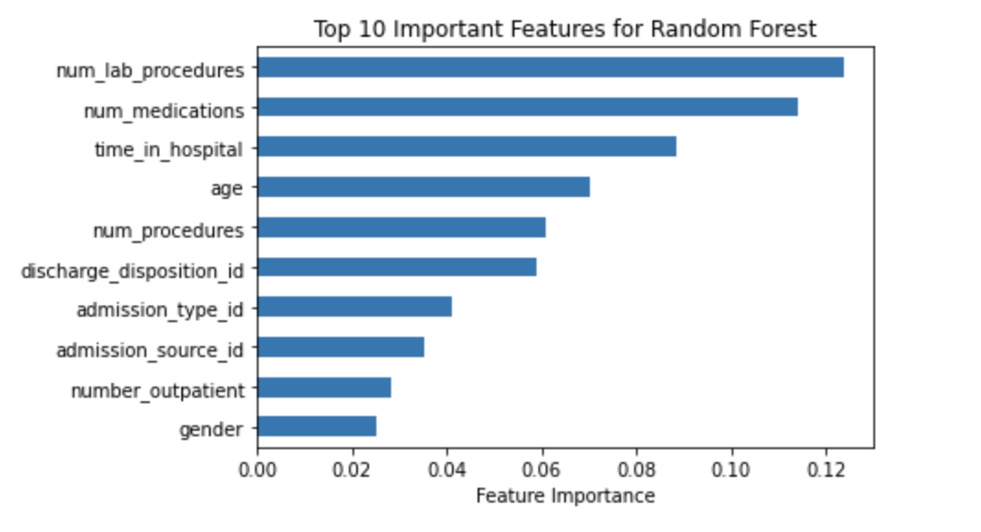
Random Forest Important Features

Slide 20
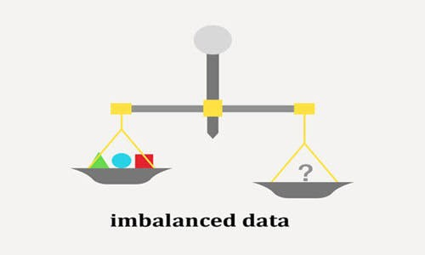
Lessons learned and recommendations
Our random forest model had higher metrics than our decision tree model
Random forest and decision tree models share the same top 10 features
Data labels need to be balanced properly
Still room for data improvement and model tuning

Slide 21


Patient Personas
Persona 1
Persona 2
Older by age
More health complications
More engaged with the healthcare system
Higher hospital times, lab procedures, and readmission rates
Younger patients
Less engaged with the healthcare system
Have fewer complications
Slightly lower readmission rate.

Slide 22

Special care of the following patients:
Older patients
Patients with high health complications
Patients with high number of lab procedures
Patients who have spent higher hospital time in the past
Notes:
To reduce readmission rate of patients getting readmitted within 30 days more care should be taken of the following patients:
Keeping older patients under intensive care as they are at high risk.
People with high health complications
People who have had number of lab procedures in the past
People who have spent higher hospital time in the past
Special attention to people belonging to Caucasian and African-American race.

Slide 23
PART 4
Future Project Plan

Slide 24
Project Plan Phase Two (CRISP-DM Process model)
Phase One
Phase Two - Future
Business Understanding
Business Understanding
Data
Understanding
Data
Understanding
Data
Preparation
Data
Preparation
Modeling
Modeling
Evaluation
Evaluation
Deployment
Notes:
To strengthen our model, we have outlined a six-phase plan: Business Understanding, Data Understanding, Data Preparation, Modeling, Evaluation, and Deployment.
Owing to time constraints, I'll delve into two of these phases in detail: Data Understanding and Deployment.

Slide 25



Data Understanding
Outdated Data
(1999-2008)
Missing Critical Variables
Data Collection Strategy
“The dataset does not include many important factors such as access to care, which has been shown in one study to account for 58% of variation readmission rates.” Reference
Notes:
Currently, our dataset is somewhat outdated, spanning 10 years from 1999 to 2008. Additionally, it may be missing critical variables. For instance, one article states, “The dataset does not encompass many pivotal factors like access to care, which, according to a study, accounts for 58% variation in readmission rates.”
We intend to gather new data

Slide 26
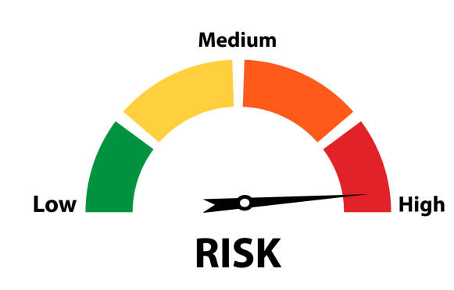
Deployment
Identify interventions
Design the experiment
Implement the experiment
Patients at high risk of being readmitted within 30 days.
Examine the experimental results
Integrate successful methods with the model
Notes:
Beyond just the model, its application is crucial. After identifying patients at high risk of readmission within 30 days, what are the subsequent steps? What are the medical intervention we should do? To address this, we've designed a 5-step deployment strategy:
Identify interventions
Design the experiment
Implement the experiment
Examine the experimental results.
Integrate successful methods with the model.

Slide 27




Risks and Mitigation Plans
Risks
Mitigation Plans
Data Understanding
Low Quality Data
Closely monitor data quality
Deployment
Reluctant to change
Ensure smooth integration to daily workflows
Notes:
Risks
For the data quality, low data quality, the risk mitigation plan is to Closely monitor data quality
For deployment, Medical practitioners might not be willing to adapt to change
Mitigation Strategy is to ensure it smoothly integrates within daily workflows.

Slide 28
THANK YOU!

